Slide 1

CASE STUDY:CREDIT CARD
FRAUD DETECTION
SUBMITTED BY: ANUSHREE CHOURASIA

Slide 2
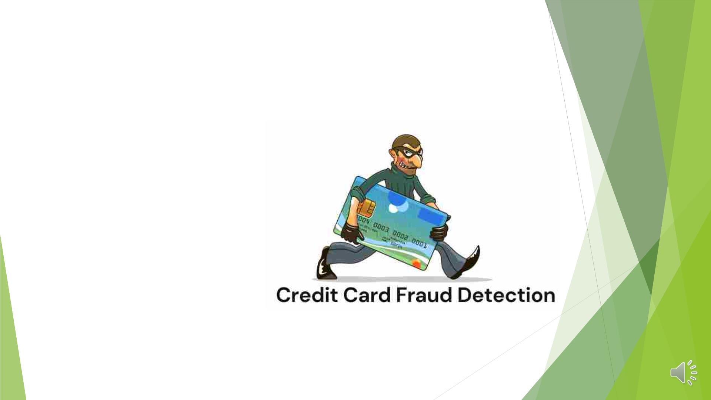
OBJECTIVE
◆ Introduction
q
q
q
Problem statement
Goals
Objective
◆ Overview of data
◆ Insights
◆ Model reflection
◆ Conclusion
◆ Business Recommendation

Slide 3

INTRODUCTION
A payment card, such as a credit card or debit card, is used to perpetrate fraud,
and this practise is referred to as credit card fraud. The goal could be to pay into
another account that is under criminal control or to acquire products or services.
The volume of credit card fraud transactions has significantly increased recently.
Retaining highly profitable customers is frequently a bank's top priority. Banking
fraud, however, poses a serious threat to achieving this objective.
Other than this, there are the following other techniques to conduct fraudulent
transactions:
◆ Altering or manipulating real cards
◆ Production of fake cards
◆ Misplaced or stolen credit cards
◆ Malicious telemarketing

Slide 4
PROBLEM STATEMENT
◆ In the financial industry, utilising machine learning to detect credit card fraud
is essential.
◆ They must set up proactive monitoring and fraud defence systems.
◆ Algorithms for detecting fraud using machine learning are far more effective
than humans.
◆ Machine learning for fraud detection is based on the idea that fraudulent
transactions differ from legitimate ones in a number of ways.
◆ These institutions benefit from machine learning –
q To cut back on laborious manual reviews
q Hefty fees and chargebacks
q Rejection of legal transactions.

Slide 5
GOALS
◆ Work on a fraud detection model and it’s cost-benefit
analysis as a member of the analytics team.
◆ Create a machine learning model that uses historical
transactional data from customers with a pool of
merchants to identify fraudulent transactions.
OBJECTIVE
◆ Analyze the effects of these fraudulent transactions on
the business and suggest the best steps the bank can take
to reduce the risk of fraud.

Slide 6
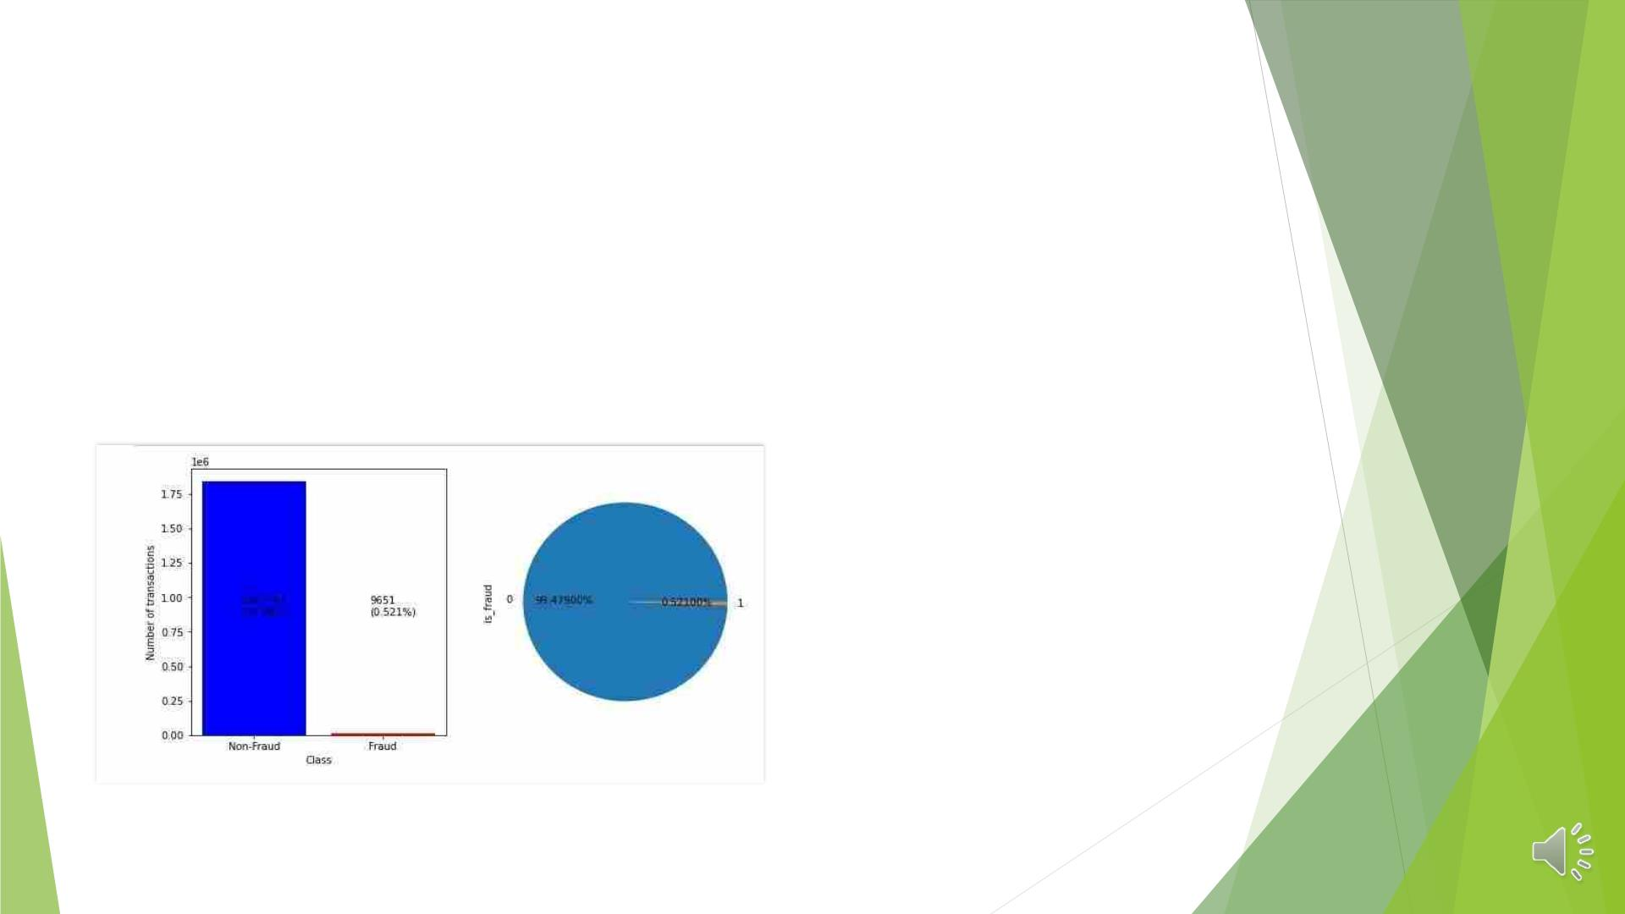
OVERVIEW OF DATA
◆ Fraud data = 9651 transaction (0.521%)
◆ Non Fraud data= 1842743 transactions(99.48% )

Slide 7
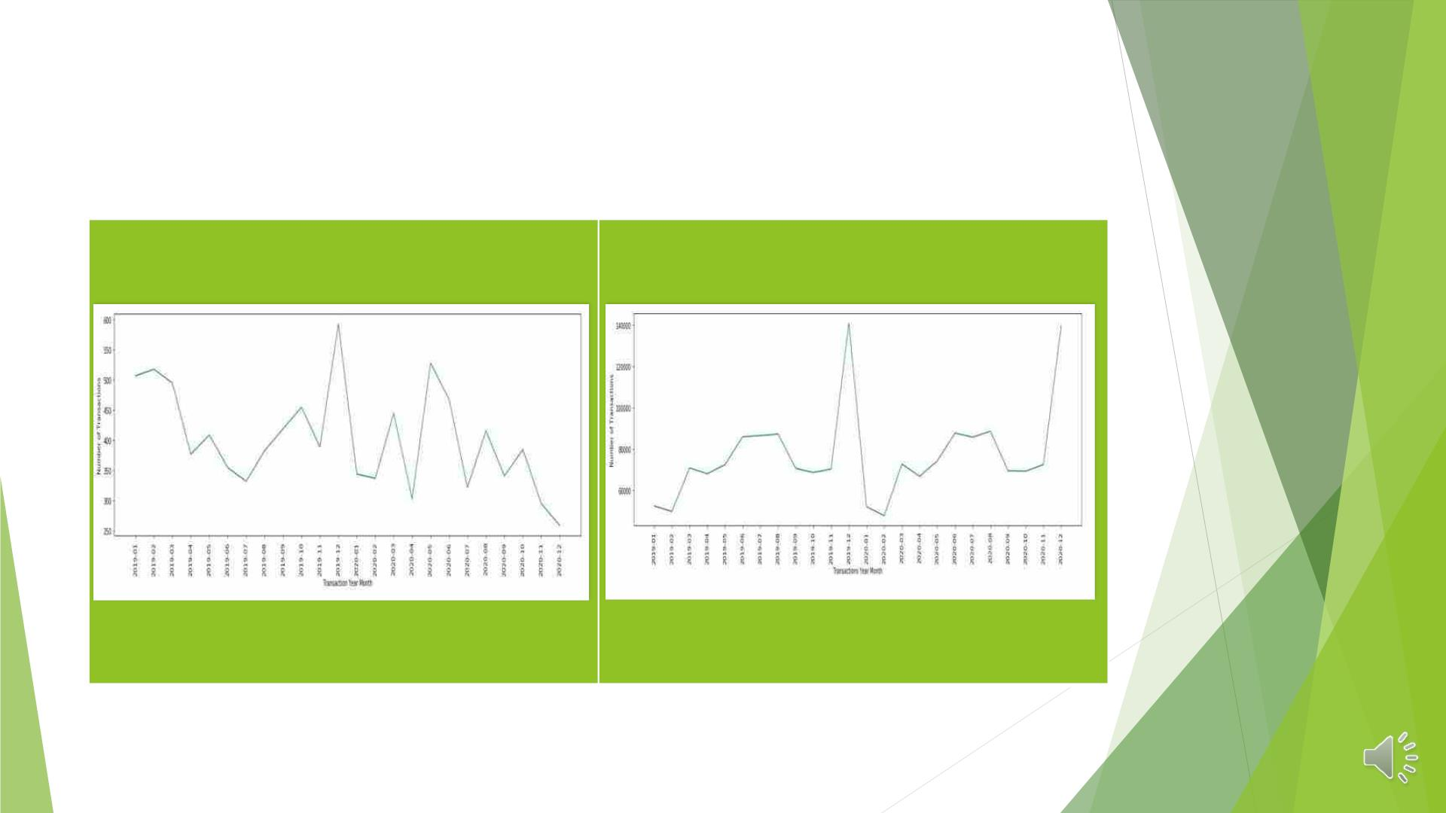
VISUAL REPRESENTATION OF FREQUENCY OF
TRANSACTIONS AND FRAUD TRANSACTIONS
MONTH WISE
No. of fraud transactions done month wise No of transactions done month wise
Ø Fraudulent transactions spiked on December 31st in particular, then in May, August,
and October.

Slide 8
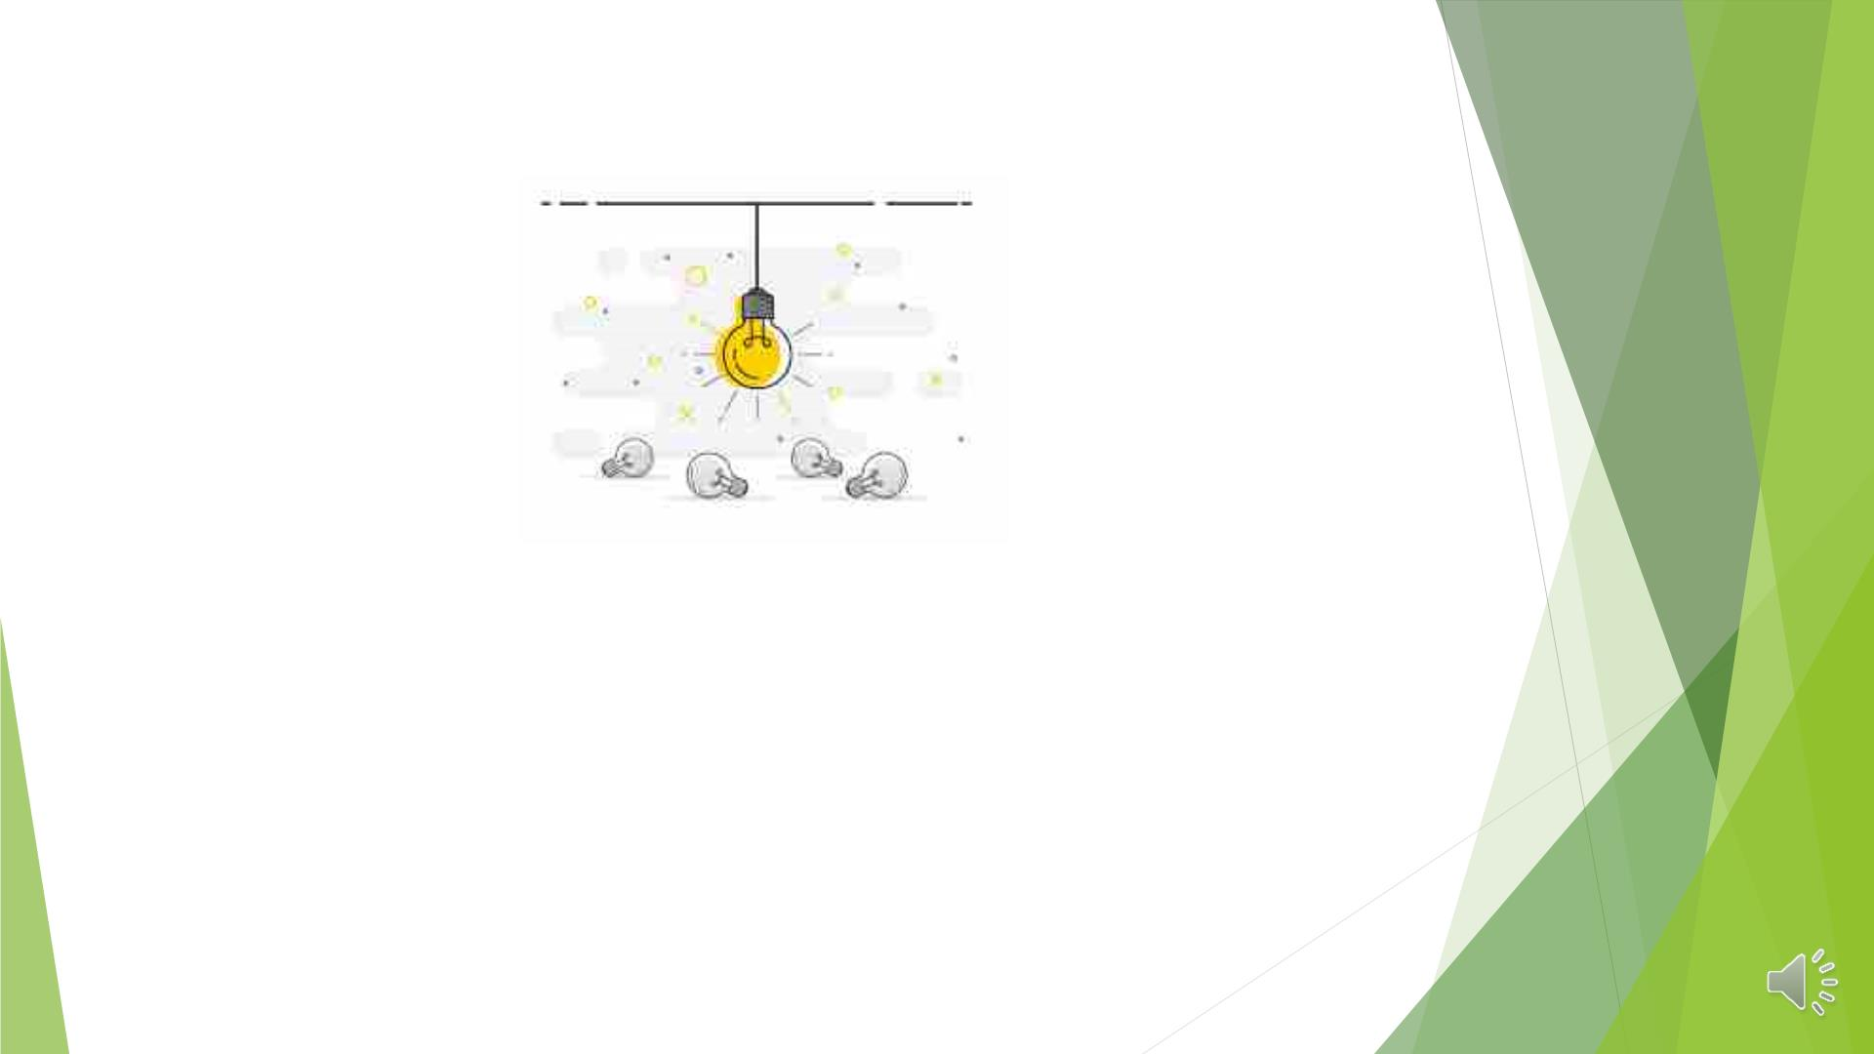
INSIGHTS
◆ Plots can help you comprehend frauds occurring on credit cards given
to bank clients.
◆ Visual analysis for improved comprehension based on fraud data(1)
and non-fraud data(0).

Slide 9
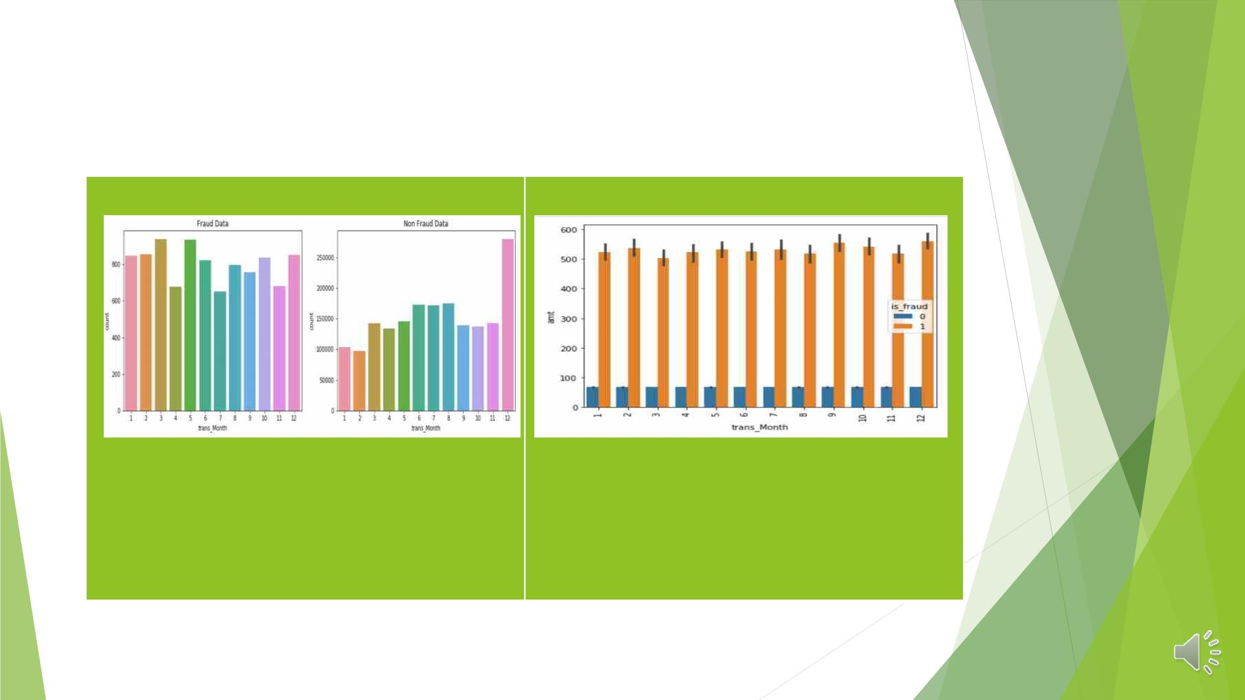
• ANALYSIS BASED ON FRAUDULENT TRANSACTIONS IN
VARIOUS MONTHS
In the third and fifth months,
where the number of legitimate
transactions is lower, there are
more fraudulent transactions.
Almost the same sum was spent on
fraud-related transactions during
the month.

Slide 10
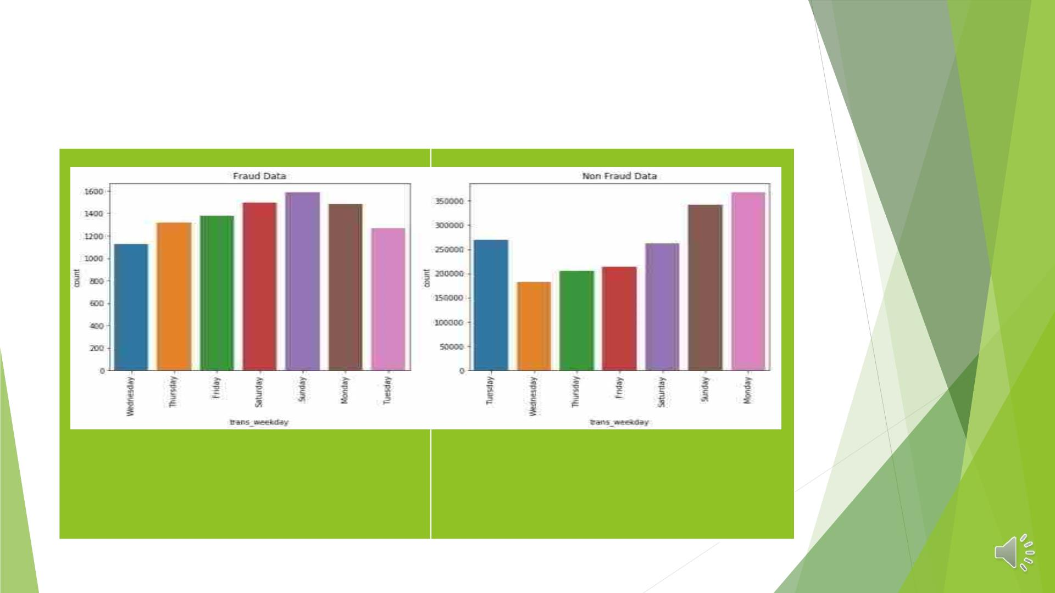
• ANALYSIS BASED ON FRAUDULENT TRANSACTIONS DURING
THE WEEK
In comparison to the number of
Throughout the entire weekday,
nearly the same amount was spent
on fraudulent transactions.
regular transactions, the number of
fraudulent transactions is higher on
Sunday, Saturday, and Monday.

Slide 11
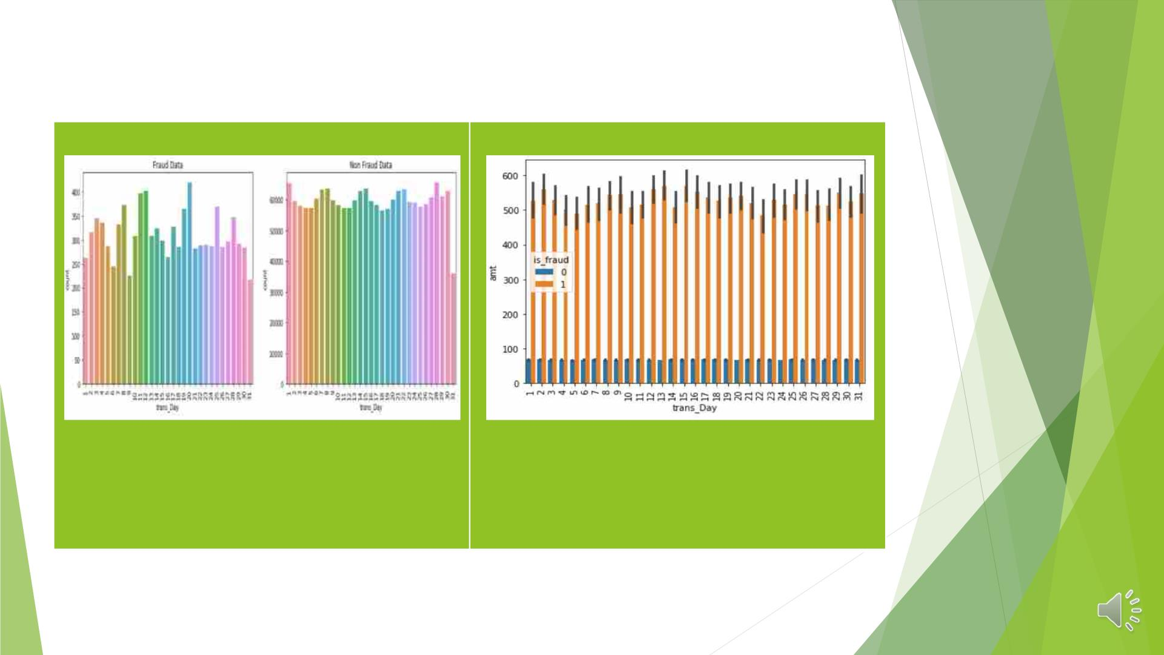
• ANALYSIS BASED ON FRAUDULENT TRANSACTIONS IN DAYS
The 20th, 12th, and 11th days of the
month have the highest counts of
fraudulent transactions.
The maximum amount that can be spent
on fraudulent transactions is the same
every day of the month.

Slide 12
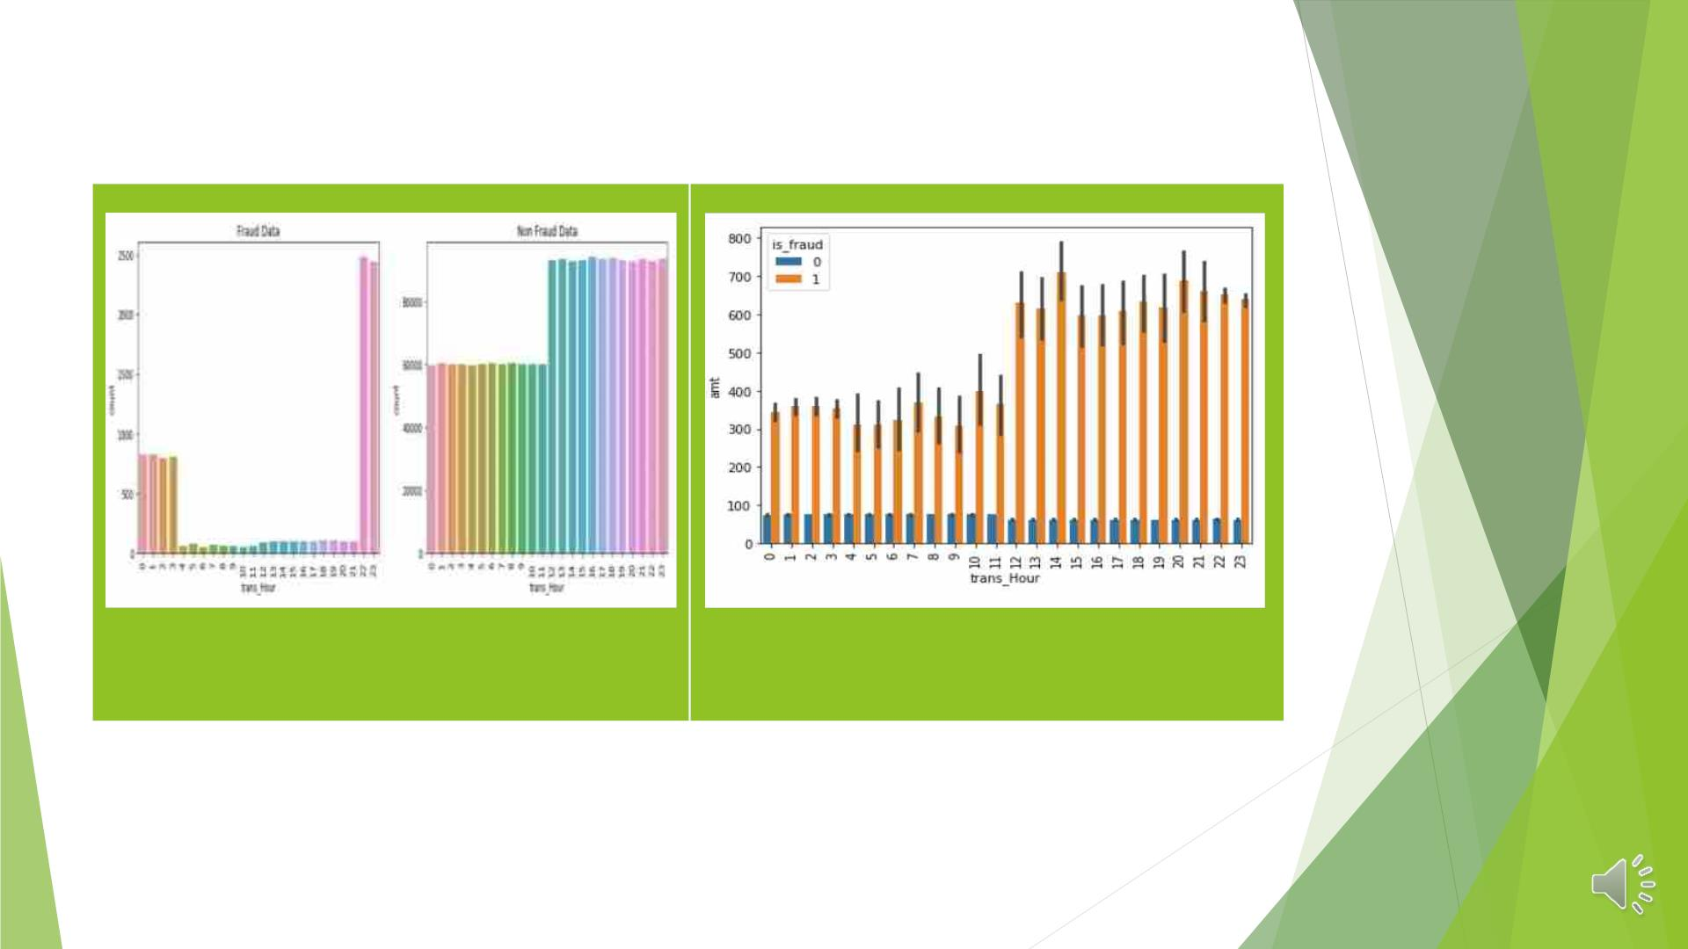
• FRAUDULENT TRANSACTIONS ANALYSIS DONE IN HOURS
Fraudulent transactions are carried out
between the hours of 22 and 3 in the
morning.
The largest sums were spent on
fraudulent transactions between the
hours of 12 and 23.

Slide 13
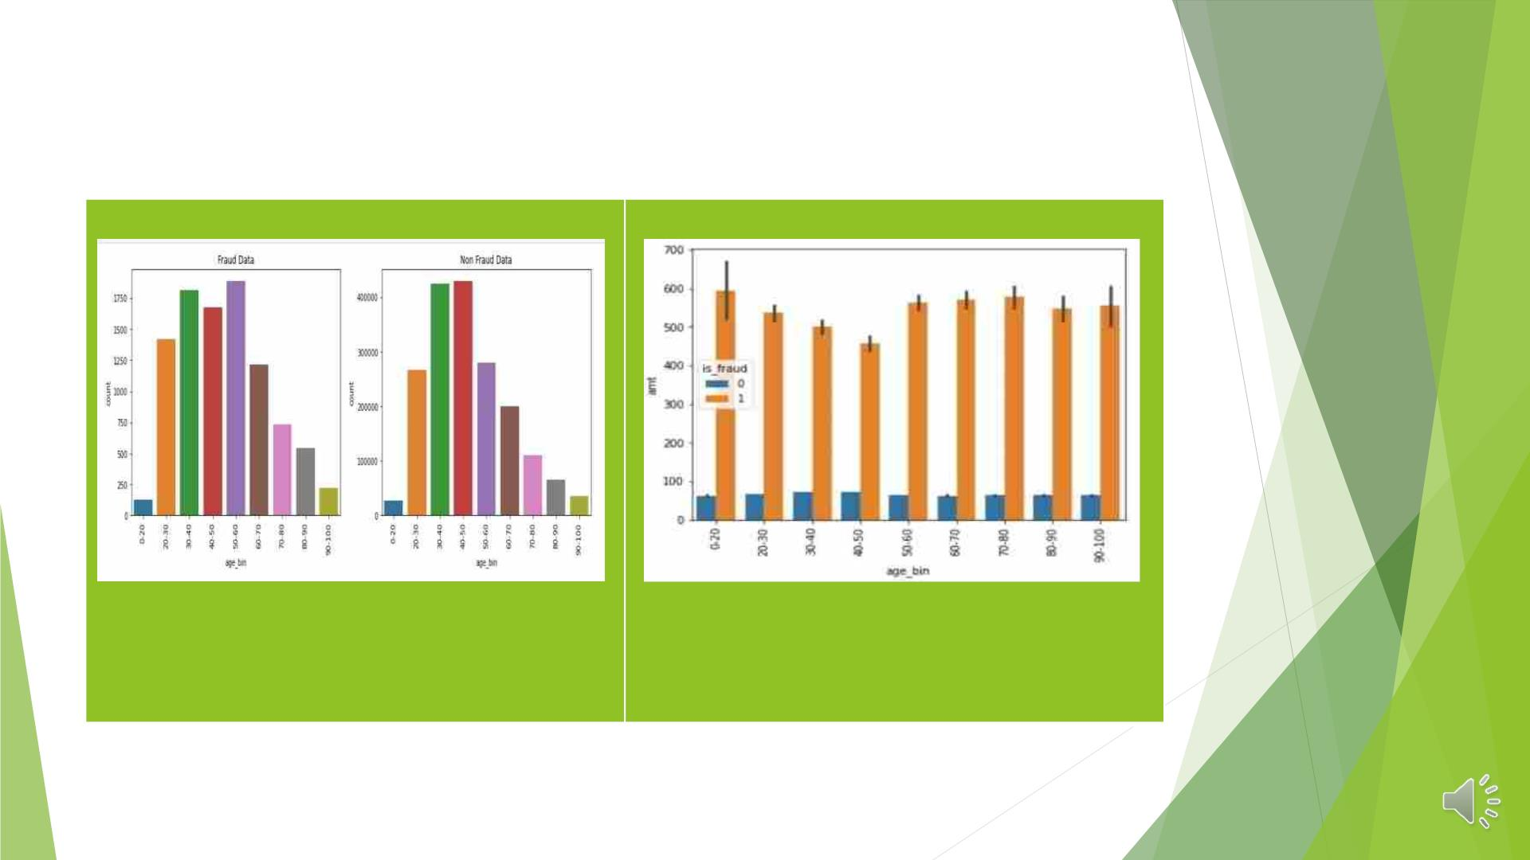
• FRAUDULENT TRANSACTION ANALYSIS IN DIFFERENTAGE
BINS
The age groups of 50 to 60, 30 to 40,
and 20 to 60 have seen an increase in
the number of fraud transactions.
The "0-20," "60-70," and "70-80" age bin
of credit card holders can spend the
most money on fraudulent purchases.

Slide 14
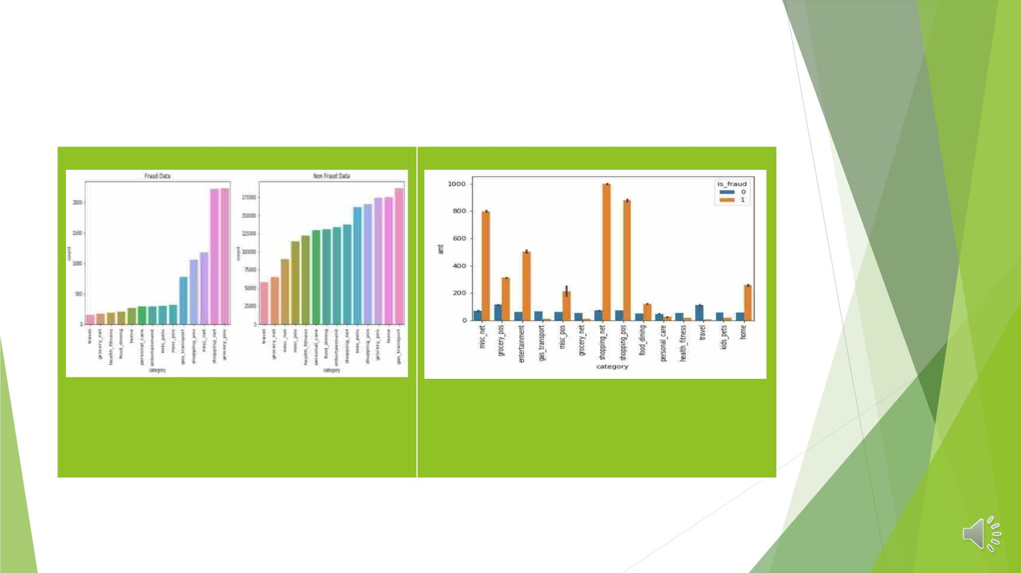
• FRAUDULENT TRANSACTIONS FROM DIFFERENT
CATEGORIES WERE ANALYZED
The number of fraudulent transactions has
For fraudulent transactions, the most
amounts were spent on shopping_net,
shopping_pos, miscellaneous_net, and
entertainment.
increased at grocery_pos , misc_net,
shopping_pos, gas_transport, and
shopping_net categories

Slide 15
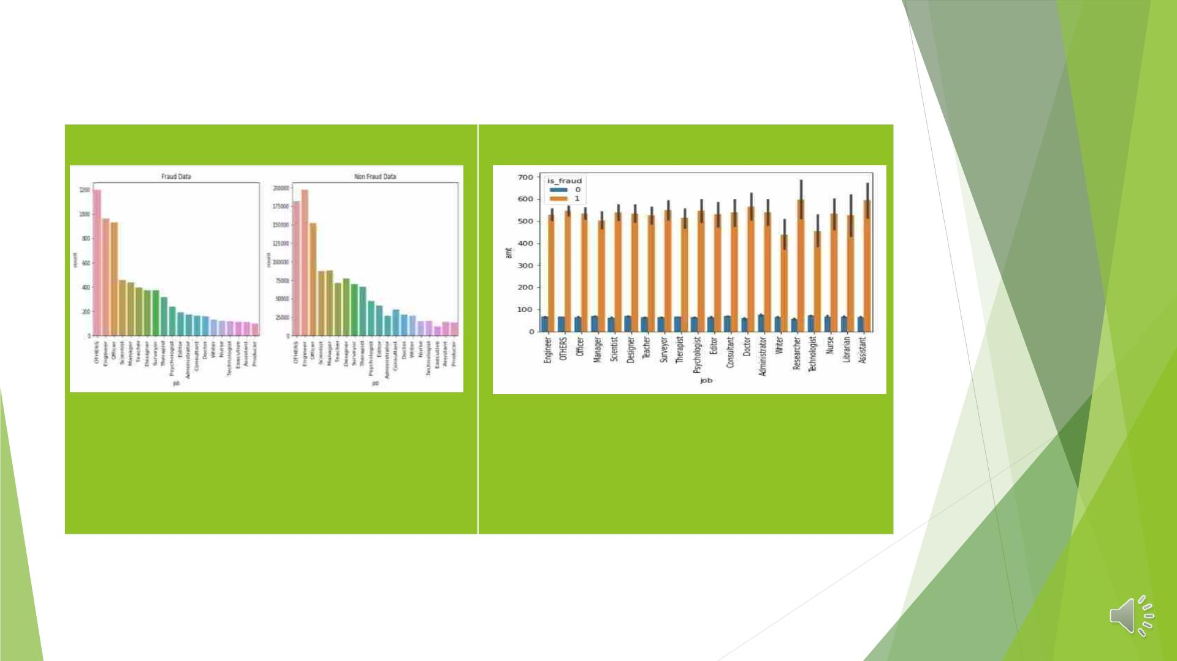
• ANALYSIS BASED ON FRAUDULENT TRANSACTIONS IN VARIOUS JOBS
More transactions involving fraud are
being made in Scientist, officer, engineer,
and others Categories
The highest amount spent for fraudulent
purchases was spent by Assistant and
Researcher credit card holders.

Slide 16
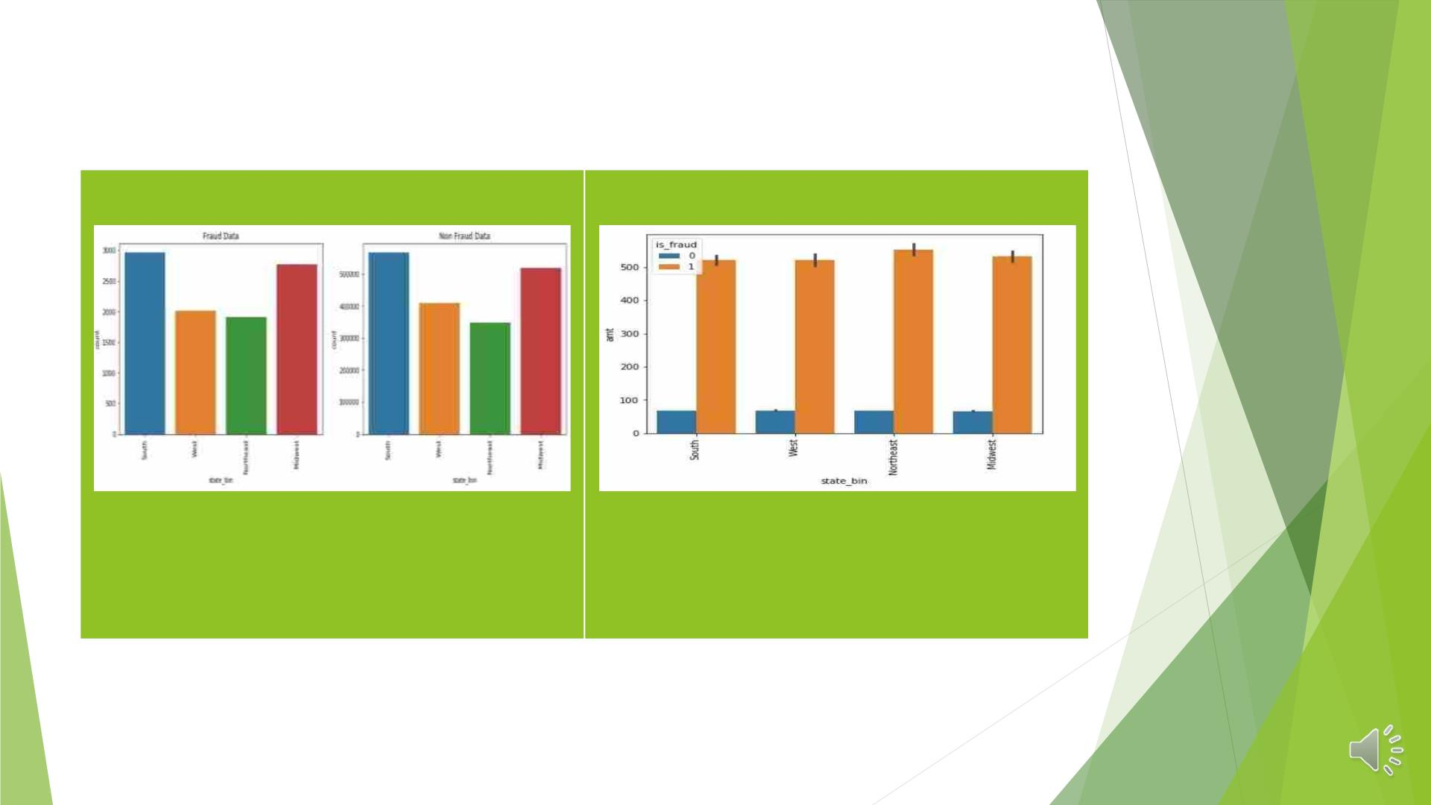
• ANALYSIS BASED ON FRAUDULENT TRANSACTIONS BASED ON
STATE_BIN (REGION_WISE)
The South and Midwest regions have
a higher rate of fraud transactions.
The amount spent on fraudulent
transactions is the same across all
regions, but it is significantly higher
in the Northeast.

Slide 17
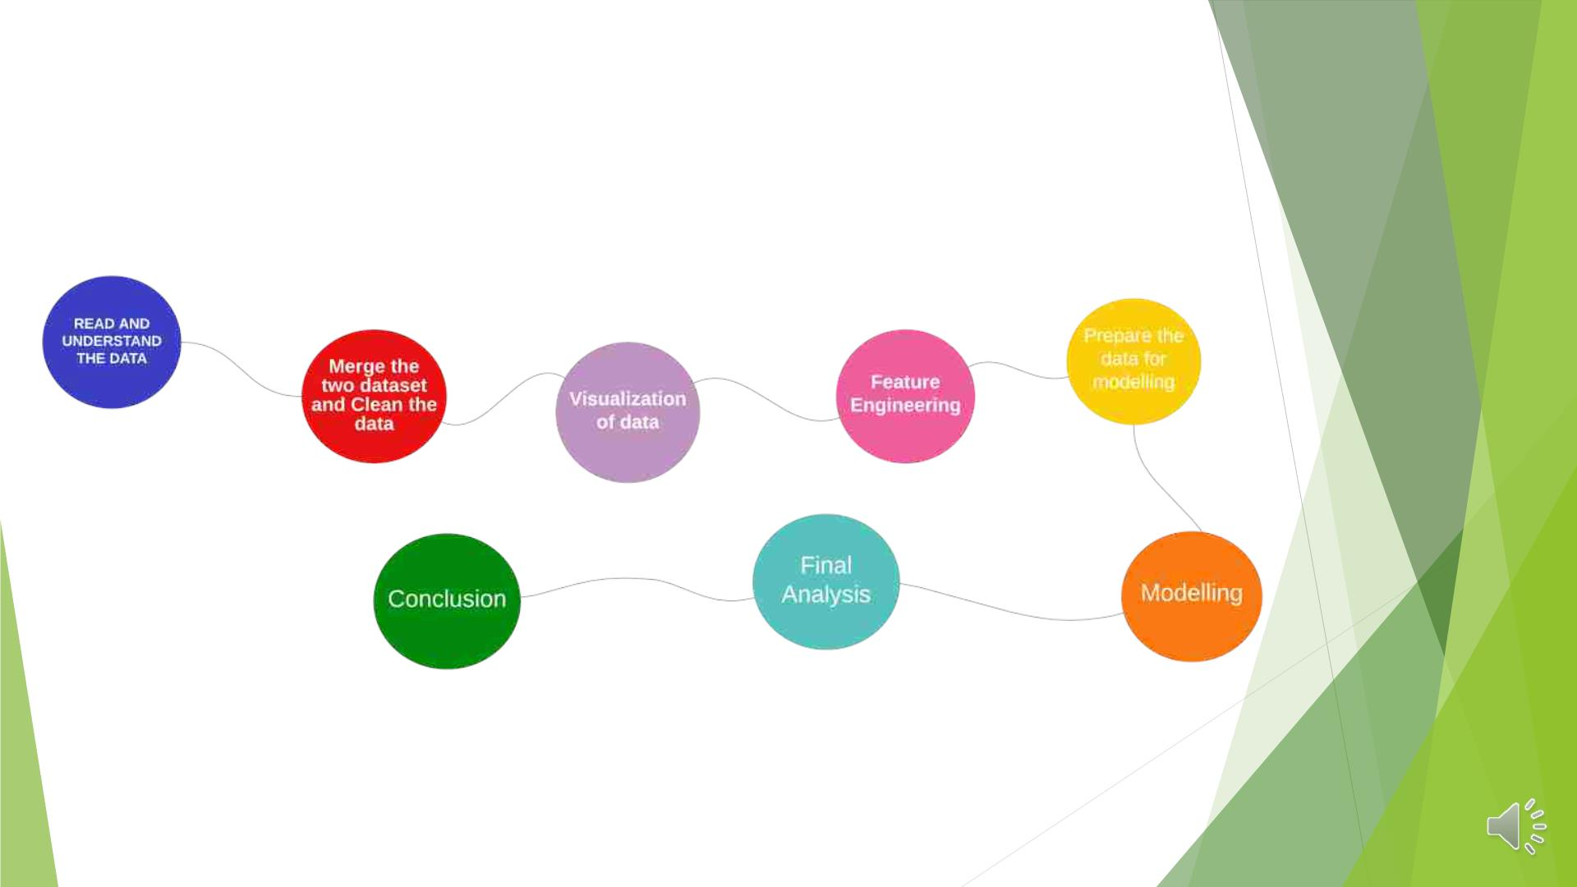
MODELLING
◆ FLOW CHART :

Slide 18

Prepare Data For Modelling
Drop high
correlated
variables
Label encoding
(variable on
large categories)
Data ready for
the splitting
into X,y
(train,test)
Dummy creations
(variable on
counted
categories)

Slide 19
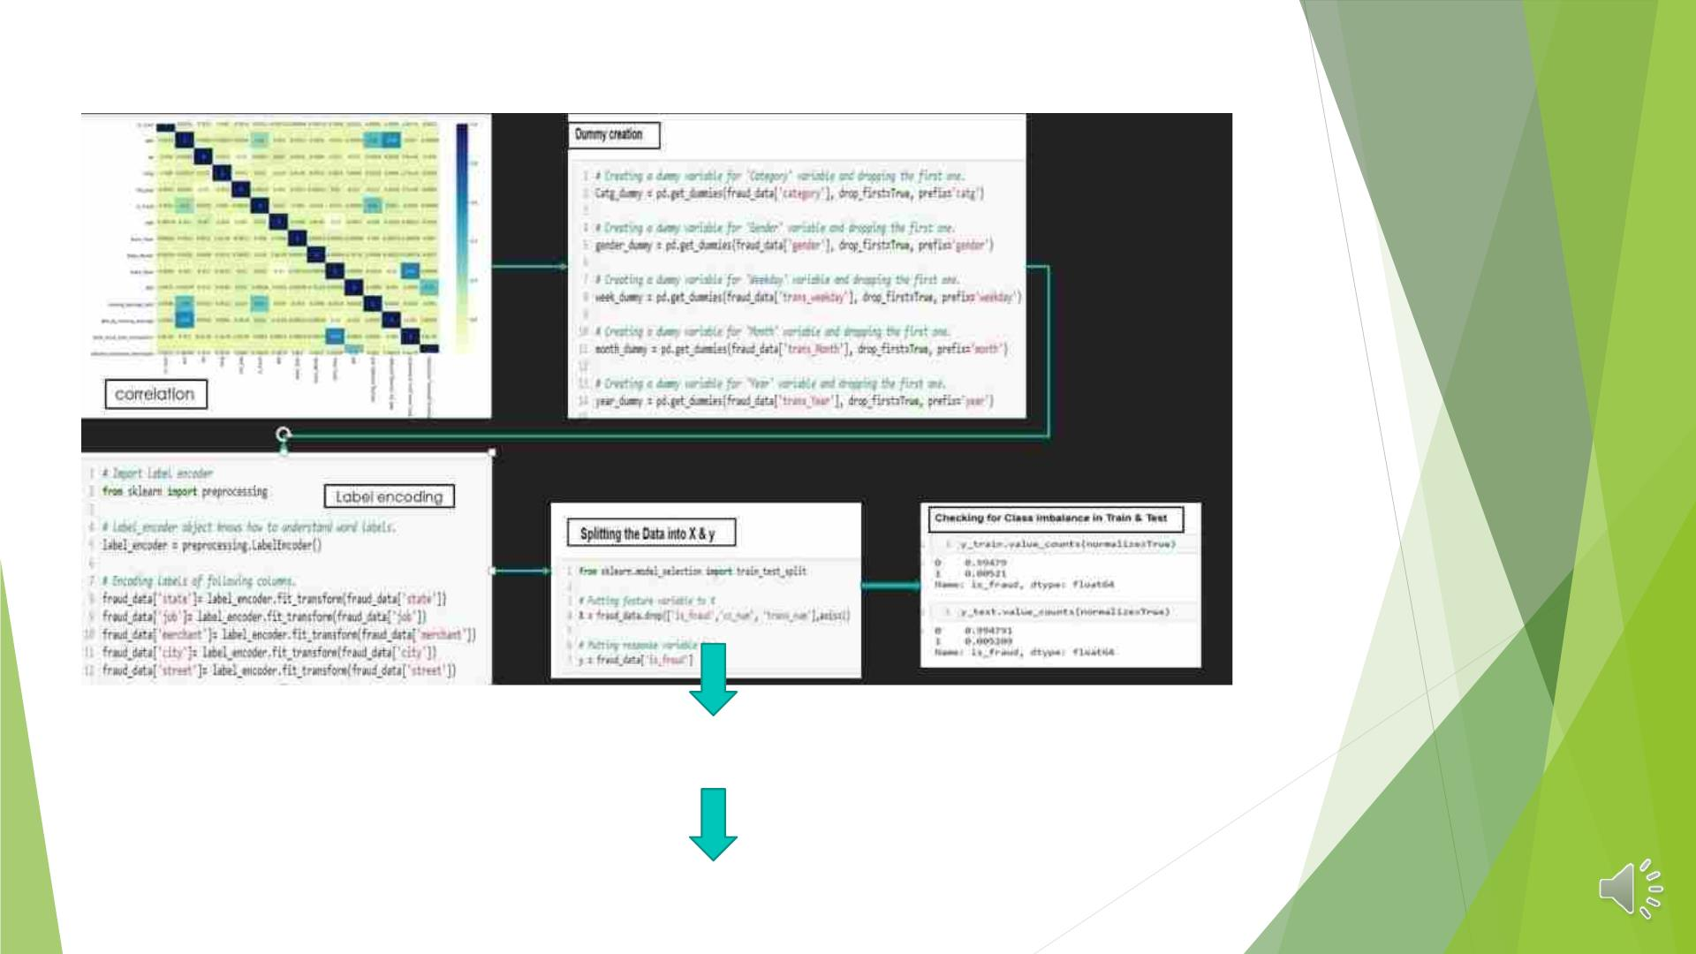
Treating the class imbalance
(using SMOTE / ADASYN)
Then start
MODELLING

Slide 20
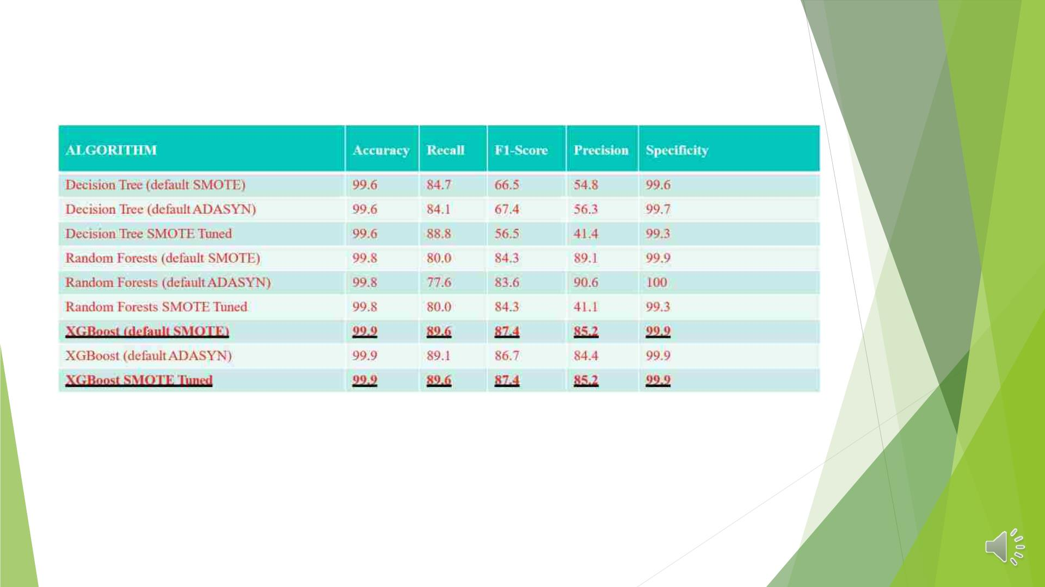
MODELLING STATS
Both the models of XGBoost i.e modelling done using default parameter using SMOTE
and Hyper-tuned model using SMOTE data of XGBoost are producing the same
findings, thus one of them can be used for additional study.

Slide 21
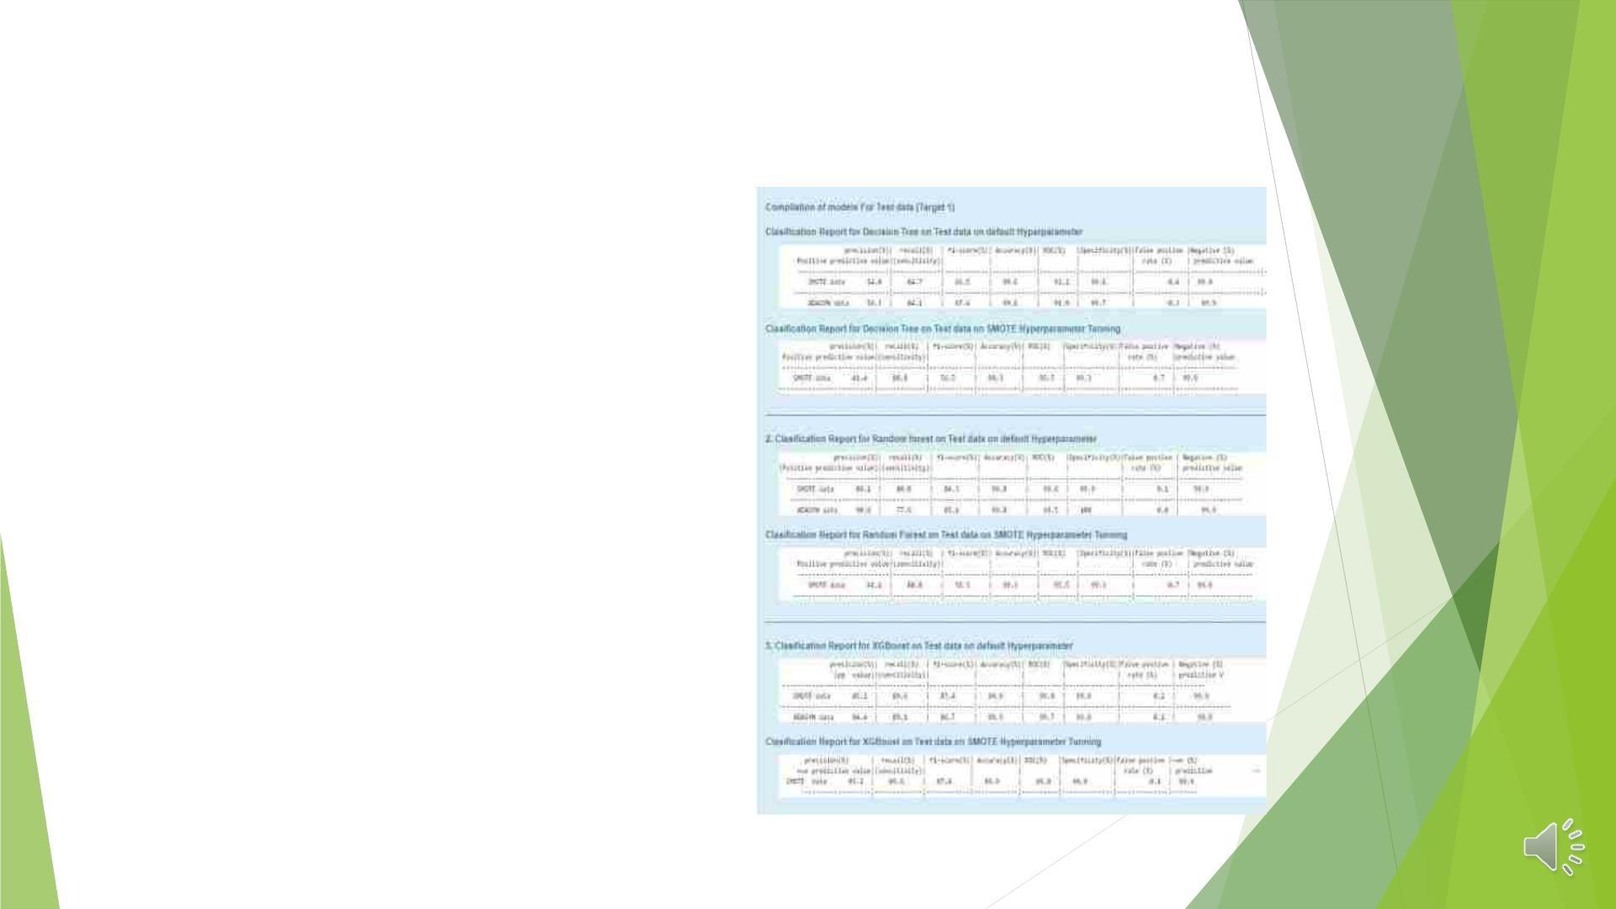
MODEL REFLECTION
◆ We will choose XGBOOST (Hyper-parameter
Tuning) for SMOTE data as our final model
based on the accuracy, ROC, precision, and
recall of several models.
◆ Test recall is 89.6%, ROC is 99.8%, and test
accuracy is 99.9%.
◆ The highest recall rate of all other models is
89.6% due to fraudulent transactions. Since
precisely identifying fraudulent transactions
is more crucial to our business purpose than
non-fraudulent transactions. High recall
means that practically all fraudulent
transactions will be successfully identified by
the model.
◆ Because of this, the performance of the
XGBOOST (Hyperparameter Tuning) model for
SMOTE data is selected.

Slide 22
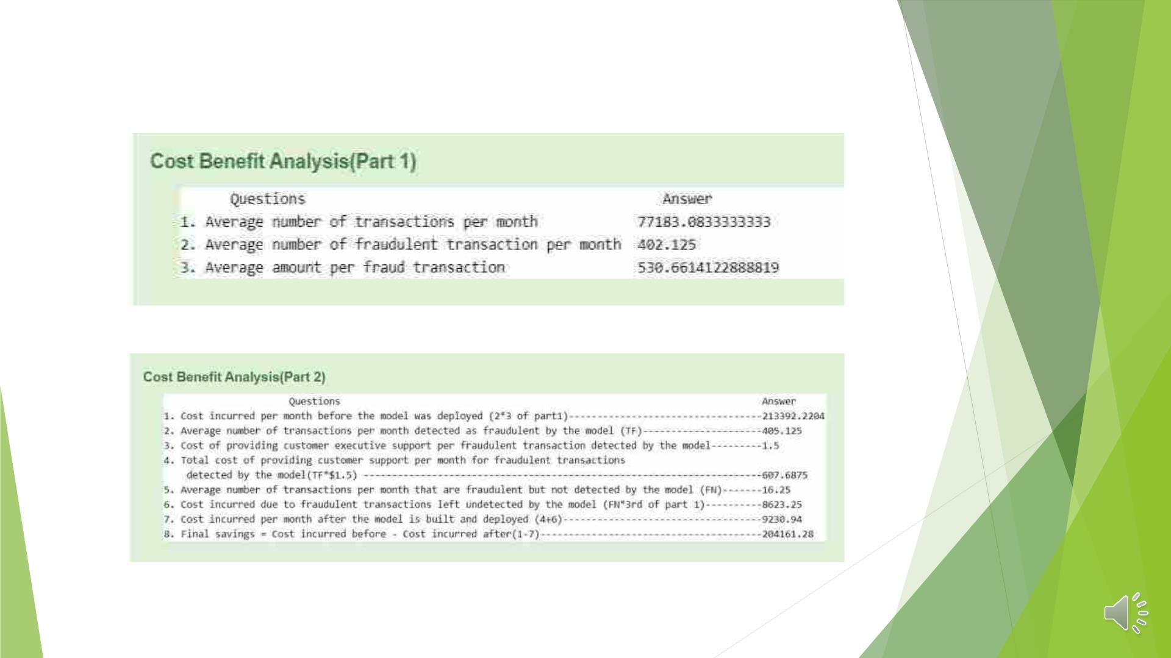
COST BENEFIT ANALYSIS

Slide 23
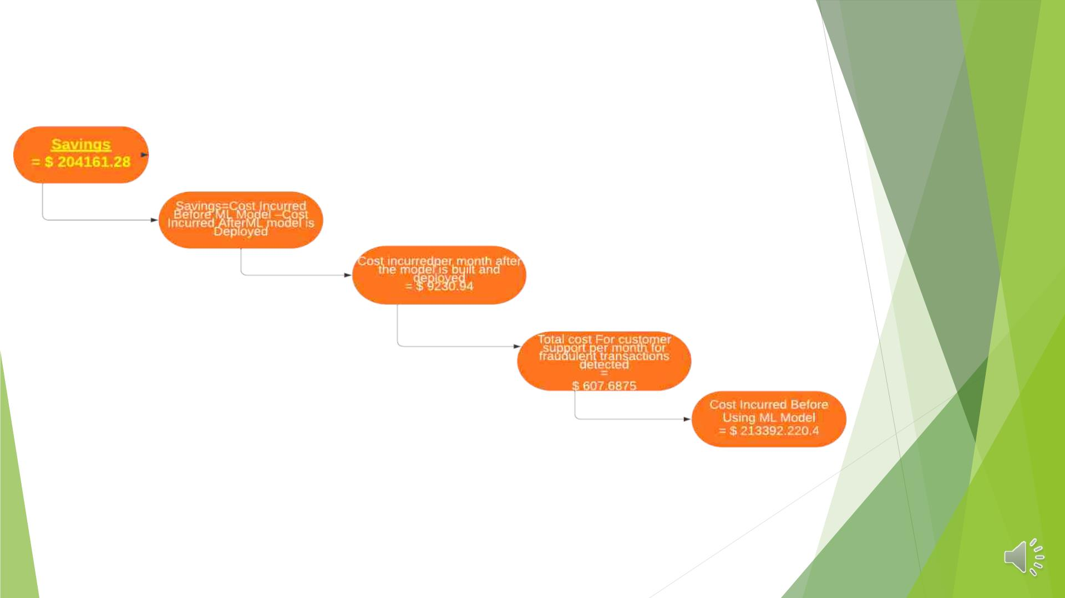
CONCLUSION:PROFIT PREDICTED AFTER USING ML MODELS
◆ Hence 95.67% of drastic decrease in amount paid by the bank to the
customer for their loss by fraud transactions using this Model.

Slide 24
BUISNESS RECOMMENDATION
◆ With an increase in "hist trans avg amt 24h" values, a transaction's likelihood of being
a fraudulent transaction rises. We determined "hist trans avg amt 24h"—the average
amount credit card holders spent on transactions over the previous 24 hours—based on
their spending habits. Therefore, it is appropriate for the bank to send an SMSALERT!
to the consumer confirming the transaction if the amount spent in the last 24 hours is
comparable to the amount spent in the past.
◆ As the value of a transaction on Thursday, Saturday, and Monday during the workweek
rises, the likelihood of a fraudulent transaction also rises. According to the pattern
model, the busiest days for fraud are Thursday, Saturday, and Monday. Therefore,
banks must exercise extreme caution and alertness during these days to prevent
fraudulent transactions in these categories.
◆ With an increase in "amt" values, the likelihood that a client may engage in fraudulent
transactions rises. In the event that a bank ever finds that a transaction's nature or
size exceeds typical spending patterns, it should act promptly by providing the
necessary alerts to clients.

Slide 25
BUISNESS RECOMMENDATION
◆ The likelihood that a client may engage in fraudulent transactions rises as the
values for the categories "home," "shopping," "grocery," "health and fitness,"
and "gas transportation" rise. As these are the platforms where any customer
would spend a high transactional amount, fraudsters also follow the same
trend, the model anticipated that major fraud transactions would occur in the
categories. It is always advised that the bank monitor the history of spend
amount through FLASH SMS ALERT while providing the relevant credit card
holders with a thorough transaction history.
◆ The majority of fraud transactions occur between the hours of 22 and 3 Hr ,
thus banks must be sure to send an SMSALERT during these unusual hours.

Slide 26
THANK YOU

